Slide 1



Bank Customer Management System
This presentation outlines our IEEE-RAS Embedded Project, focusing on a console-based bank customer management system. Our team collaborated to develop a robust and user-friendly application, integrating core banking functionalities with persistent data storage and secure operations.
He
3 Contributors

Slide 2





« Our Team »
Mohamed Nasser
Kareem Kotb
Ibrahim Mohamed
Hagar Marzouk

Slide 3
Project Overview
Console-Based System
Account Management
Transaction Features
A command-line interface for managing bank accounts.
Functions to add, edit, view, and delete customer accounts securely.
Support for money transfers, deposits, and withdrawals with robust checks.
Persistent Storage
User Experience
All customer data is saved to and loaded from a 'customers.txt' file.
Emphasizes safe input validation and a clean, intuitive user interface.

Slide 4





Project Structure
1
2
4
3
1
main.c
Handles the main menu and user interaction logic.
2
functions.c
Contains the core business logic and file I/O operations.
3
functions.h
Defines data structures (structs) and function declarations.
4
customers.txt
Serves as the persistent data store for all customer information.

Slide 5



Data flow of Project
1
Start the program
2
Load all customer data from file
3
Show menu to user
4
Take user choice
5
Perform the selected operation
6
Save updated data to file
7
Repeat the process
»The system reads saved data at startup, performs operations based on user input, updates the customer list, and writes changes back to the file to ensure persistence.

Slide 6
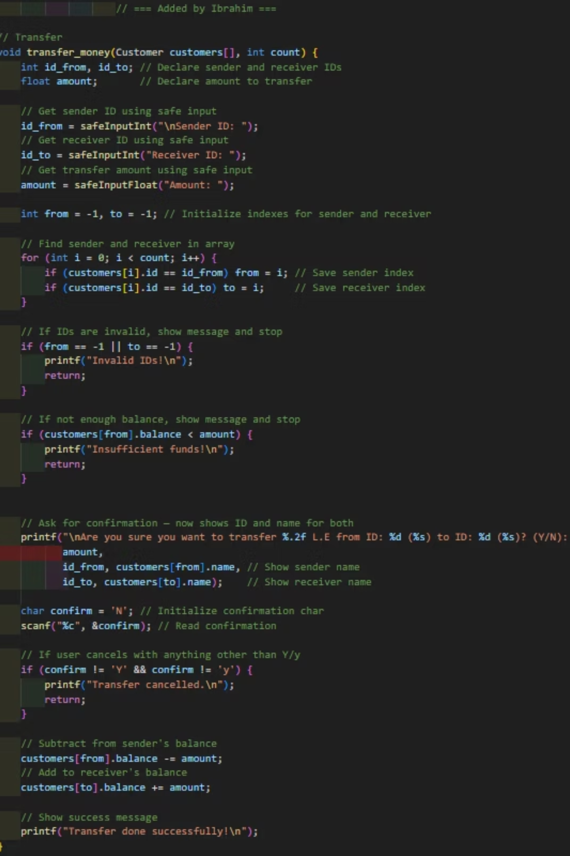
Transfer_Money
Purpose:This function safely transfers money from one customer to another.
Steps:
Prompts the user to enter Sender ID, Receiver ID, and Amount.
Searches for both IDs in the customer list.
Validates that both customers exist.
Checks if the sender has enough balance for the transfer.
Asks the user for a final confirmation before transferring.
If confirmed, deducts the amount from the sender’s balance and adds it to the receiver’s balance.
Shows success or error messages as needed.

Slide 7
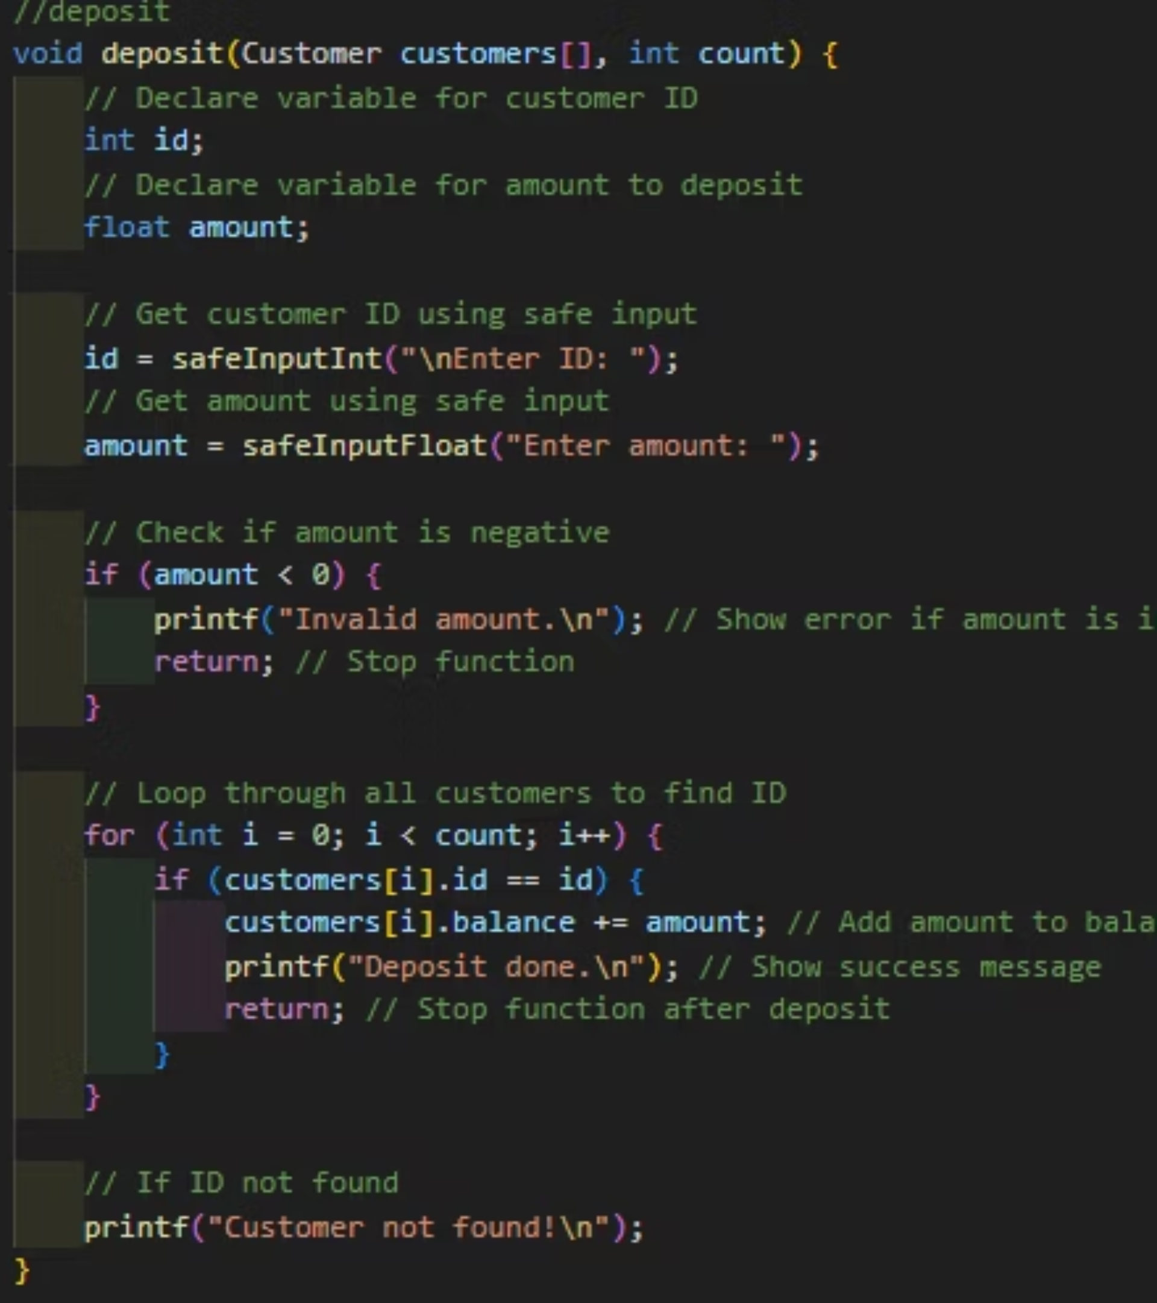
Deposit
Purpose:This function allows a customer to deposit money into their account.
Steps:
Asks the user to enter the Customer ID and the Amount to deposit.
Checks if the amount is valid (not negative).
Searches the customer list for the given ID.
If found, adds the amount to the customer’s balance and confirms the deposit.
If the ID is not found, it shows an error message.

Slide 8
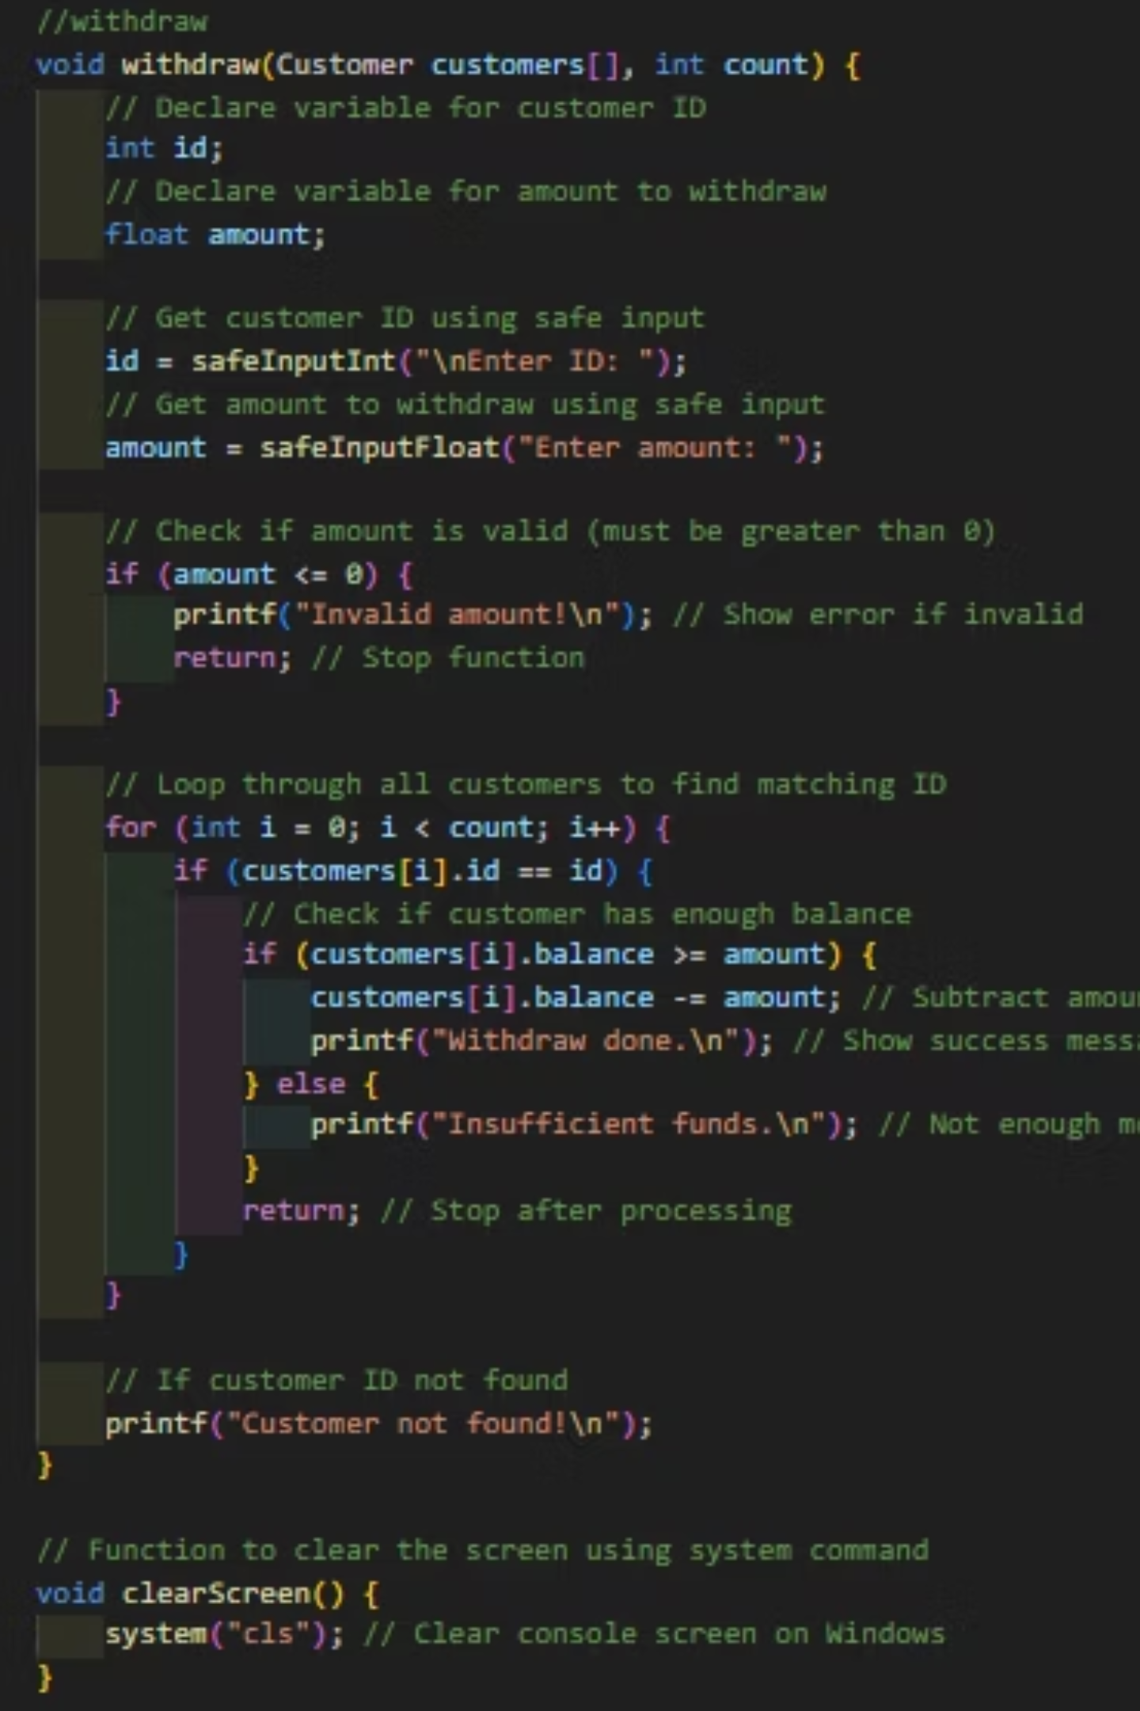
Withdraw
Purpose (Withdraw):This function allows a customer to withdraw money from their account.
Steps:
Prompts the user to enter the Customer ID and Amount to withdraw.
Checks if the amount is valid (greater than zero).
Searches the customer list for the given ID.
If found, checks if the customer has enough balance.
If enough, it deducts the amount and shows a success message.
If not enough balance, it shows an error message.
If the ID is not found, it shows an error message.
Purpose (Clear Screen):This helper function clears the console screen using the system command (cls for Windows).

Slide 9
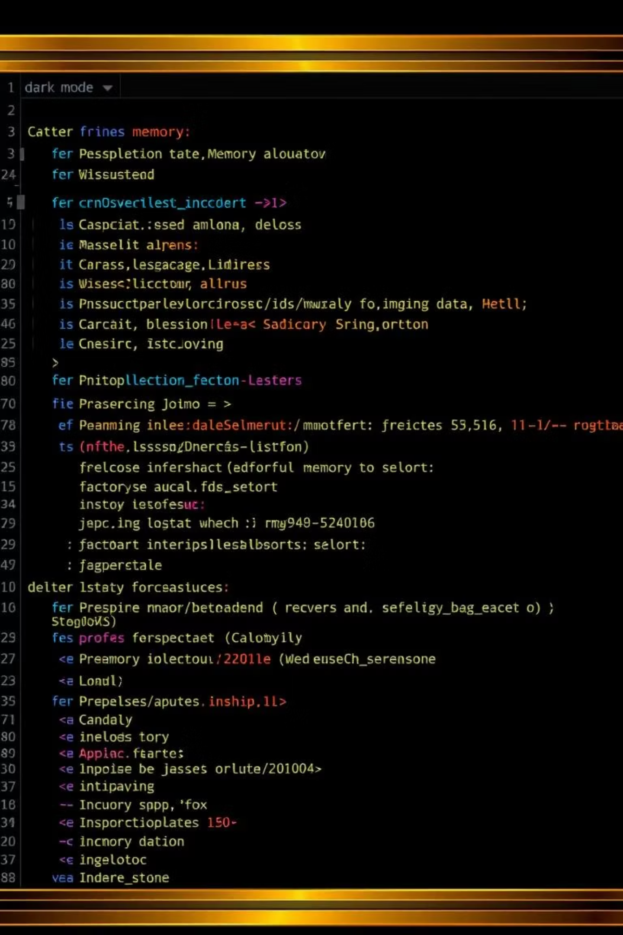
Code Snippet: Creating a Customer Account
;ID = safeInputInt("Enter ID: ") ; customers[count].id = ID ;++count
This snippet shows how we handle customer data using a static array.We collect input safely using safeInputInt and safeInputfloat, store the ID directly in the static array, and increment the customer count.This method is simple, efficient for small-scale systems, and avoids the complexity of dynamic memory.

Slide 10

File I/O (Saving & Loading)
Our system uses file I/O to keep customer data saved between sessions. When the program starts, it loads existing customer records from customers.txt. After any change (add, edit, delete, transfer), the updated data is saved back to the file. Each customer is stored in one line in the text file:
« ID Name Phone Balance »

Slide 11
Key Learnings and Takeaways
Modular Programming in C
Mastered breaking down complex problems into manageable, reusable modules.
Struct Arrays for Data
Gained proficiency in using C structs and arrays for efficient data storage.
Git and Branch Workflow
Became adept at collaborative development using Git branches and pull requests.
Safe Input Handling
Implemented robust input validation to ensure system stability and data integrity.
Project Structuring
Developed skills in organizing project files and documenting code for clarity.

Slide 12






Features Implemented
Account Management
Money Transfer
Full CRUD operations for customer accounts: Add, Edit, Delete.
Securely transfer funds between different customer accounts.
Deposit & Withdraw
Auto-Saving Data
Functions for depositing and withdrawing money, including validation checks.
Automatic persistence of all data to 'customers.txt' file.
Input Validation
Static Array Storage
Robust validation to prevent system crashes and ensure data integrity.
Efficient use of a fixed-size static array of structs for data.

Slide 13

GitHub Collaboration Workflow
Branch Workflow
1
Each team member developed features on a separate branch.
2
Pull Request (PR)
Features were merged into the 'main' branch via Pull Requests.
Leader Review
3
The team leader reviewed and approved all submitted PRs.
4
Git Tracking
All contributions were meticulously tracked using Git version control.
Documentation
5
Comprehensive README and project documentation were included.

Slide 14

Thank You!
We successfully completed the Bank Customer Management System project. We are proud of our collaborative effort and the valuable skills we gained.
Presented by: NODE 1
Any Questions?

